Slide 1

Heart Disease Prediction & Model Comparison
Name – Abhinav Bansal
Sec – B / roll no. – 02 / 2118072

Slide 2
What is the need?
Many factors that affect a human heart. Problems are occurring at a rapid pace and new heart diseases are rapidly being identified.
The diagnosis of the heart diseases is a very important and is itself the most complicated task in the medical field. All the mentioned factors are taken into consideration when analyzing and understanding the patients by the doctor through manual check-ups at regular intervals of time.
So, this model is based on the dataset of various conditions to check if the given data of a person have or don’t have heart disease.

Slide 3
Importance of Heart Disease Prediction
Early Identification: Enables early detection of cardiovascular risks, allowing for timely intervention and prevention.
Improved Outcomes: Reduces mortality rates, enhances patient outcomes, and improves overall quality of life.
Cost-Efficiency: Helps allocate healthcare resources efficiently, leading to cost savings for individuals and healthcare systems.
Public Health Impact: Informs targeted public health initiatives and policies for effective prevention strategies.
Empowerment: Empowers individuals to proactively manage their cardiovascular health through lifestyle changes and informed decision-making.
Personalized Medicine: Contributes to the era of personalized medicine, tailoring interventions based on individual risk profiles.
Research Advancements: Drives ongoing research, fostering a deeper understanding of cardiovascular diseases and potential breakthroughs in treatment.

Slide 4
Dataset
The dataset used in this project was taken from the official website of Kaggle.
IT is a platform for predictive modeling and analytics competitions. Many datasets related to healthcare, including heart disease, can be found on Kaggle.
The dataset contain various conditions required for the detection of heart disease.(such as blood pressure, sugar level etc.).

Slide 5
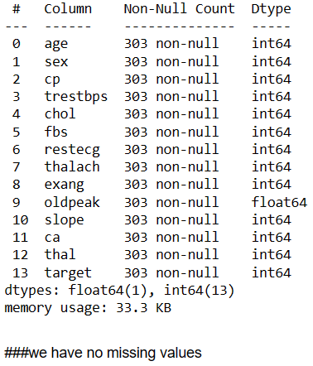
Data Preprocessing
To prevent any errors and problems in the model, we should always check the condition of our dataset.
Check if there is any NULL or missing value in the dataset.

Slide 6
Machine Learning Model
I’ve used three Machine Learning Algorithms for this project and compared their accuracies to check which works the best and worst.
Algorithms used are: Logistic Regression, Random Forest and Naïve Bayes.
Firstly, I’ve predicted the values from all of the algorithm and after then compared all of them to check which is the fastest and accurate and which is the slowest and have low accuracy.

Slide 7

Model Training
Dividing a dataset into training and testing sets is a crucial step in machine learning model development. The purpose is to assess how well the model generalizes to new, unseen data.
The dataset is then divided into two subsets: the training set and the testing set. A common split ratio is 80/20 or 70/30, meaning 80% (or 70%) of the data is used for training, and the remaining 20% (or 30%) is used for testing. The training set is used to train the machine learning model, and the testing set is used to evaluate its performance.
In this project I’ve split the data in to 80/20 ratio, 20% for testing and 80% for training.

Slide 8
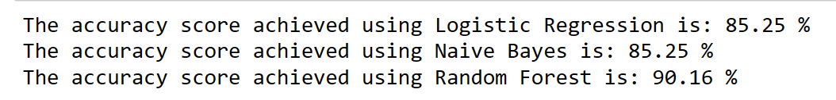
Model Evaluation
I have compared the accuracies of the Machine Learning algorithms that I’ve used in this project.
The accuracy of the Random Forest algorithm was the higher than the Logistic Regression and Naïve bayes.

Slide 9
Conclusion
The overall objective of our project is to predict accurately with less number of tests and attributes the presence of heart disease. Many more input attributes can be taken but our goal is to predict with less number of attributes and faster efficiency to predict the risk of having heart disease at a particular age span.
It is shown that Random Forest has better accuracy than the other techniques. This is the most effective model to predict patients with heart disease.
This project could answer complex queries, each with its own strength with respect to ease of model interpretation, access to detailed information and accuracy.

Slide 10
Future Implications
We are planning to introduce an efficient disease prediction system to predict the heart disease with better accuracy using Support Vector Machine (SVM).
Our project aims to provide a web platform to predict the occurrences of disease based on various symptoms. The user can select various symptoms and can find the diseases with their probabilistic figures.
Our project can be improved by implementing medicine suggestion to the patient along with the results.
We can implement a feedback from the experienced doctors who can give their views and opinions about certain medicines /practices done by the doctor on the patient.
We can implement a live chat option where the patient can chat with a doctor available regarding medication for the respective result for their symptoms.

Slide 11
THANK YOU

